Slide 1
Embedding Rendering & Behavior Configuration in Map Data
Danielle Dupuy
Dam Nguyen

Slide 2
Why do we do this? In what ways has it been useful? How we implement it.

Slide 3

Why?
Gives non-developers more control

Slide 4

Why?
Gives non-developers more control
Limits requests to web developer

Slide 5

Why?
Gives non-developers more control
Limits requests to web developer
More control with less lines of code

Slide 6
Examples
Feature colors (fill and outlines)
Symbol types and size
Populate HTML
Determine Draw Order (Panes) for feature layers
Order of Legend Items

Slide 7
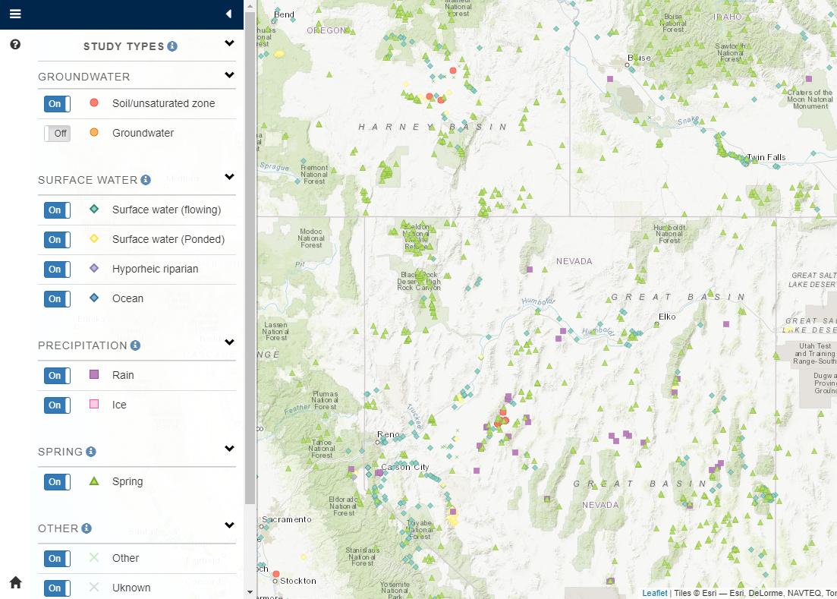

Slide 8
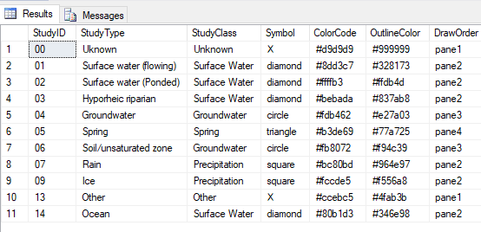
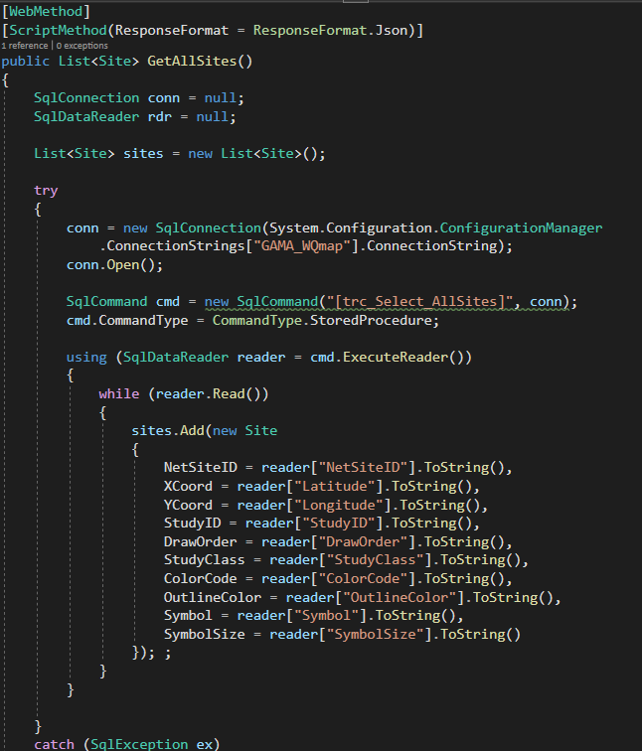
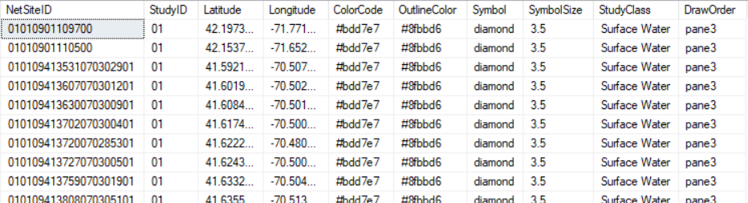

Slide 9
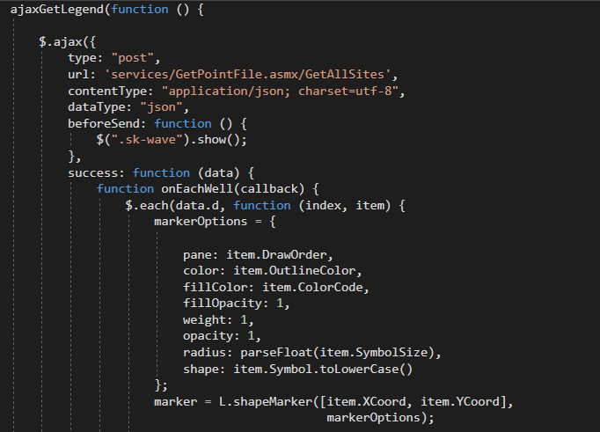
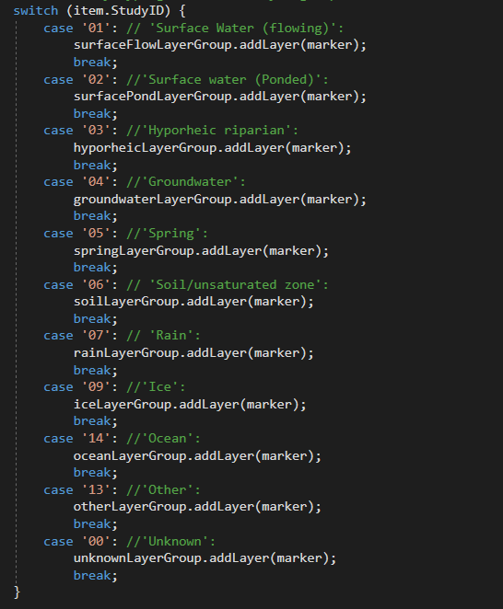
Notes:
Left: Access the stored procedure through Web Methods
Right: Use AJAX to read the data and use apply to the leaflet marker options.
I’m sure most people here are familiar with leaflet but if you’re not w
Not shown is where we create a separate layer group for each Study Type. So instead of having to make a database request for each study type or apply marker options for each study type we can do it all in one go.

Slide 10
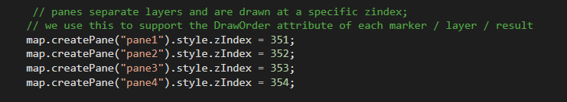

Slide 11
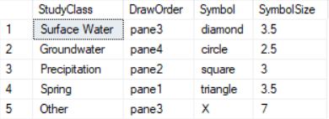
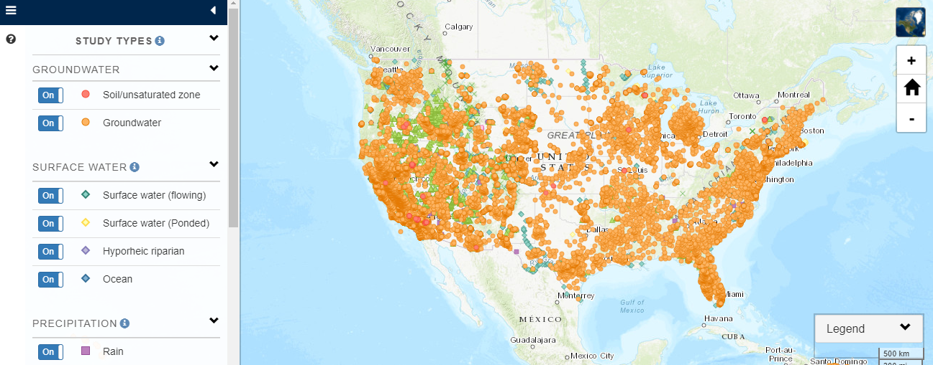

Slide 12
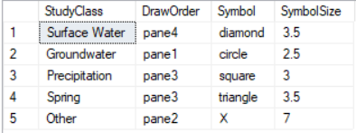


Slide 13
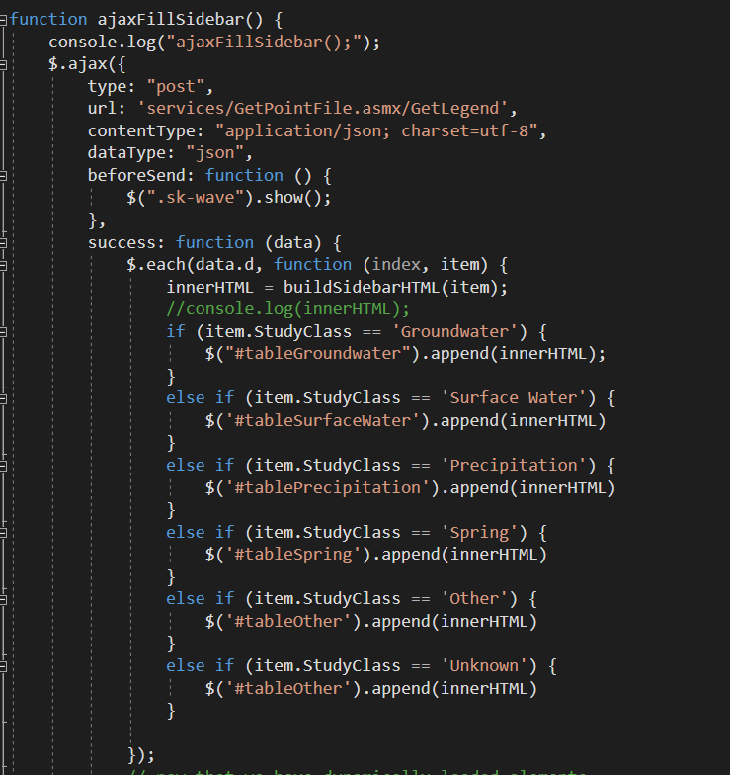
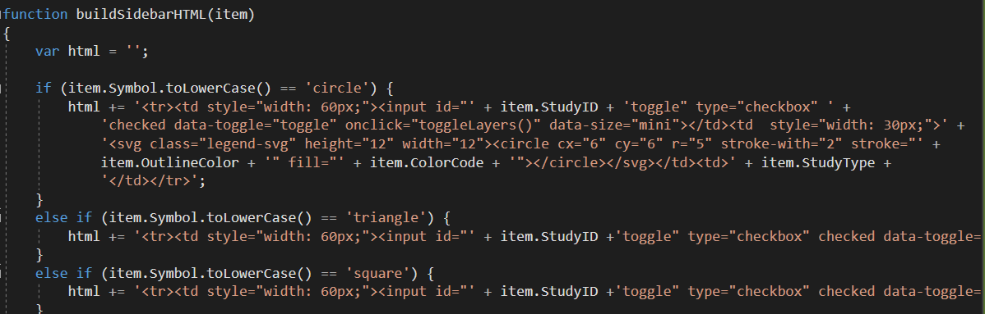

Slide 14


Slide 15
